Slide 1
MARKETING SURVEY PRESENTATION
BY: ANUSHA AMIR AND YUSRA SHAKIR

Slide 2
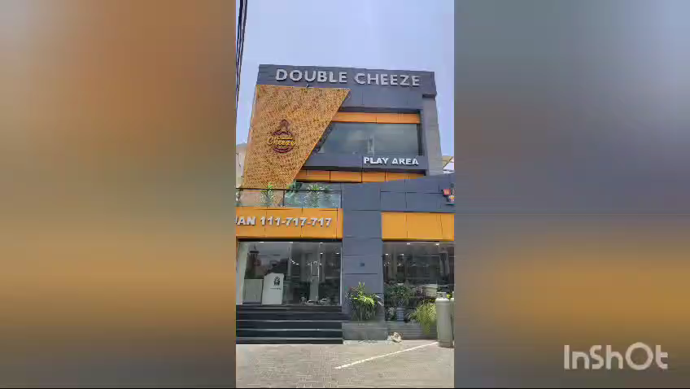

Slide 3
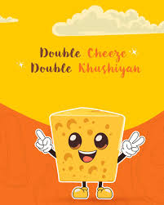
COMPANY INTRODUCTION
Established on October 1st 2023 in Multan.
Expanded to four more branches in Multan and one in Karachi.
Best known for quality foods and best customer service.

Slide 4

VALUE PROPOSITION
Their commitment to superior taste and customer satisfaction
Slogan: double cheese, double khushiyaan
High quality, diverse menu options

Slide 5

MISSION AND VISION
MISSION
VISION
Offer delicious, high quality fast food
Exceed high customer satisfaction
Also contribute to the local job market
Become a leading name in the fast-food industry
provide superior quality foods
deliver a comfy, aesthetic and memorable dining event

Slide 6

BRAND TRAITS
CORE
Quality
innovation
customer centric
REFLECTION IN MARKETING AND OPERATIONS
High quality ingredients
Innovation
Customer service

Slide 7
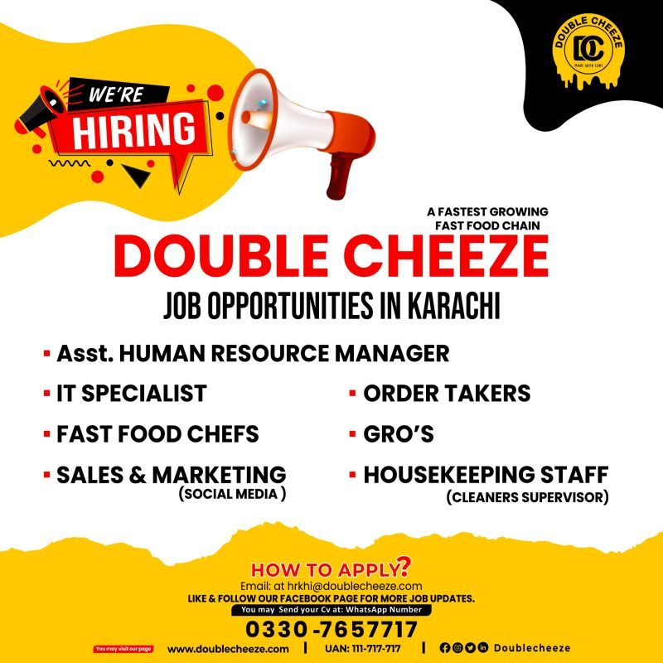
CSR INITIATIVES:
Local job markets
Detailed CSR plans to be developed

Slide 8

MARKETING PHILOSOPHY
Focus: High-quality food and exceptional dining experience
Strategies: Innovative marketing strategies
Goals: Enhance brand recognition and customer loyalty

Slide 9
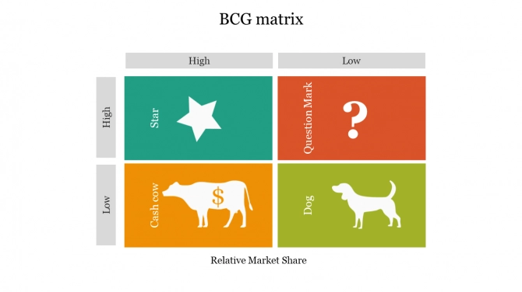
BUSINESS PORTFOLIO
PIZZA
sandwich
BURGERS AND PASTAS
WRAP & HOT COFFEE

Slide 10

COMPETITVE MARKET ANALYSIS:
Competitor Name | Website | Price Point | Product Description | Competitive Advantage/Key Features
Kababjees Fried Chicken | www.kababjees.com | Medium | Burgers, Fried Chicken, | medium prices, traditional flavors, diverse menu
KFC | www.kfcpakistan.com | low | Fried Chicken, Burgers, Wraps | Global brand recognition, extensive menu, consistent quality
Red Apple | https://www.redapple.com | medium | Burgers, Fried Chicken, Chowmein, Chinese dishes | Diverse menu with Chinese options, affordable prices
Meat the Cheese | www.meatthecheese.com | High | Gourmet Burgers, Cheese-based dishes | High-quality ingredients, gourmet experience, unique cheese-based menu

Slide 11

GAP ANALYSIS
What competitors are missing:
Kababjees Fried Chicken: Limited to traditional and standard fast food, lacking innovative menu items.
KFC: people are boycotting due to genocide
Red Apple: Less focus on premium ingredients, lacks ambiance for family dining.
Meat the Cheese: High prices, targeting a niche market of gourmet food lovers.

Slide 12
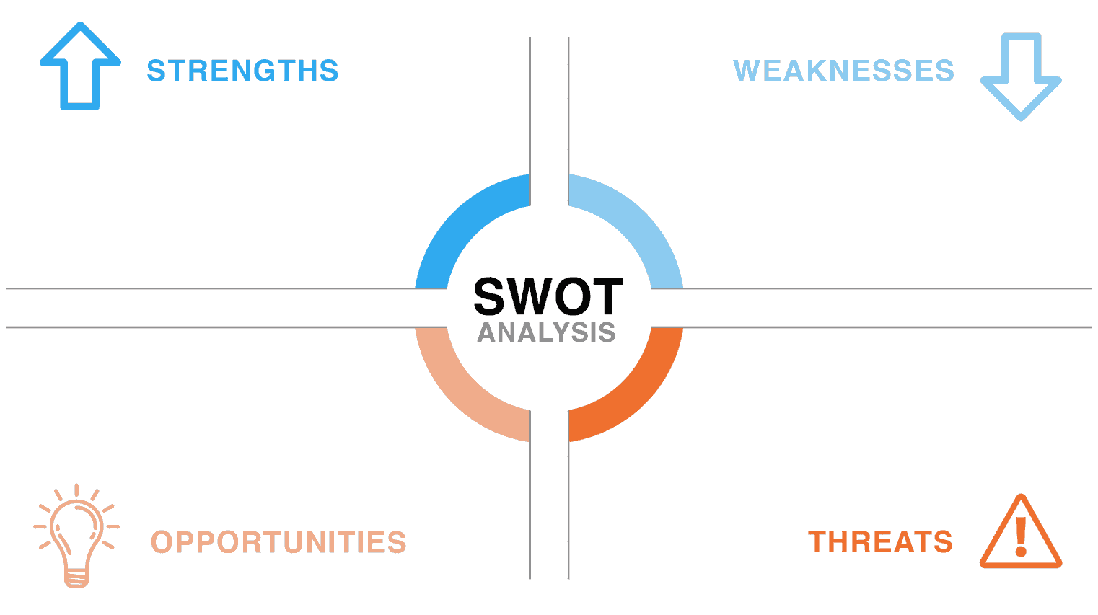
- Diverse menu- Rapid growth- High quality and attractive presentation
Limited brand recognition compared to established competitors
- Fast expansion
Intense competition, particularly in Karachi

Slide 13
Promotions
Budget Allocation: 5% of sales revenue
Social Media Marketing:
Platforms: Facebook, Instagram, Twitter
Content: Regular posts, engaging stories, interactive polls
Blogging and Influencer Collaborations:
Partner with popular food bloggers and influencers
Host live tastings and reviews
Share behind-the-scenes content and chef interviews

Slide 14
Discounts
Best Deals Introduction:
Special combo offers on pizzas, burgers, and pastas
Limited-time offers to create urgency and excitement
Grand Opening Discount:
15% Off on Entire menu during the opening week
Aimed at attracting new customers and encouraging repeat visits

Slide 15
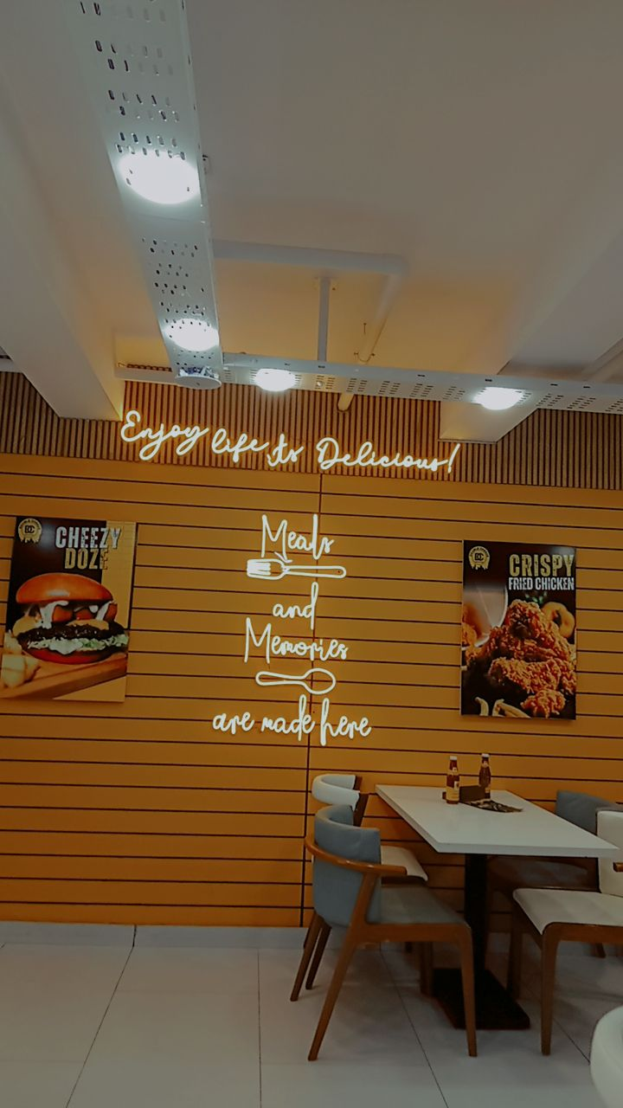
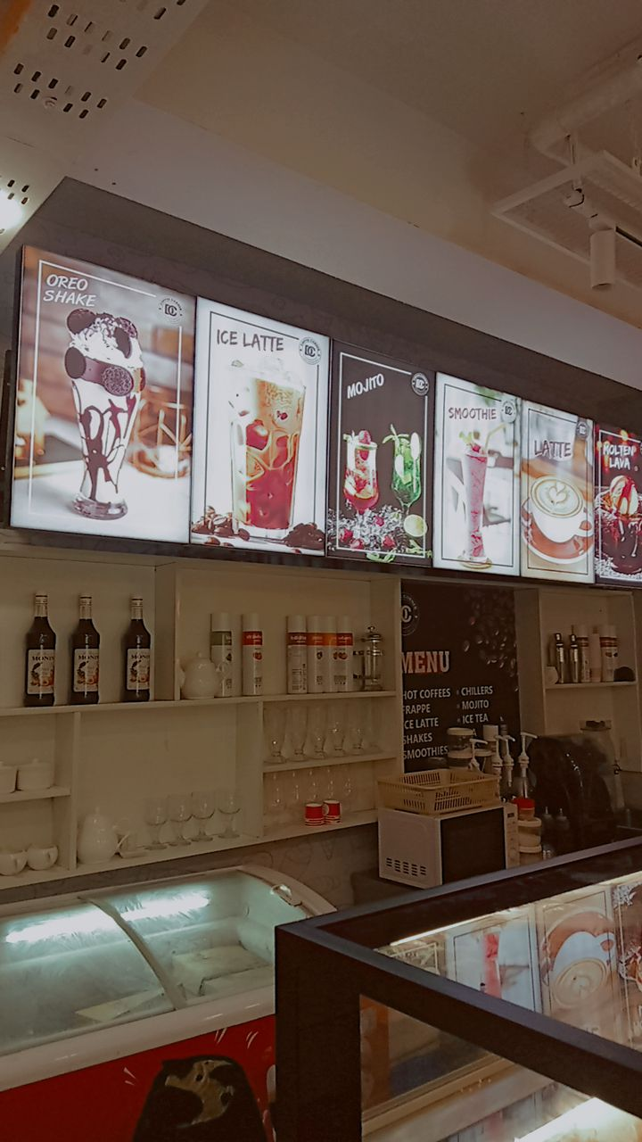
CONCLUSION
Rapid Establishment
Commitment to Quality
Customer Satisfaction.
Innovation.
Rapid Expansion
Diverse Menu
Strategic Marketing

Slide 16
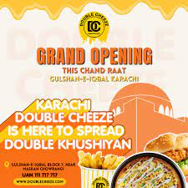
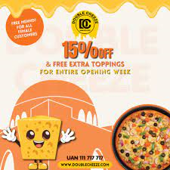

Slide 17
THANKYOU!

